Slide 1
IMI Big Data & AI Competition
Team 88: Danny Han, Edward Junsyong Lee, Junyi Hou

Slide 2
Who We Are
Edward Junsyoung Lee
Statistics (Maj), Psychology (Maj)
Key Interests: Data Analysis Techniques, Machine Learning Research
Junyi (Harvey) Hou
Statistics (Maj), Technology, Coding & Society (Maj)
Key interests: Data Analysis, Data Science, Data Engineering, AI Development
Danny Han
Statistics (Maj), Computer Science (Min), Math (Min)
Key Interests: Software Development, Data Analysis, Machine Learning

Slide 3
Introduction: Deliverables Summary
[Task 1] AML Knowledge Library: (Website + Documentation) Over 147 red flags and typologies, focused on organized crime, with full source traceability and a document that maps red flags to data signals and features we use later.
[Task 2] Bad-Actor Detection Pipeline: We clean and engineer features from the original data, run a rule-based scorer and several unsupervised ML models, fuse rule-based and ML scores, and output risk scores and flagged customers. You get both a single submission pair of CSVs and per-model outputs.
[Task 3] Explanation For All Customers: Short, non-technical text that says why someone was flagged or not, using the same risk categories as the library, plus an optional GUI to browse and search those explanations.

Slide 4
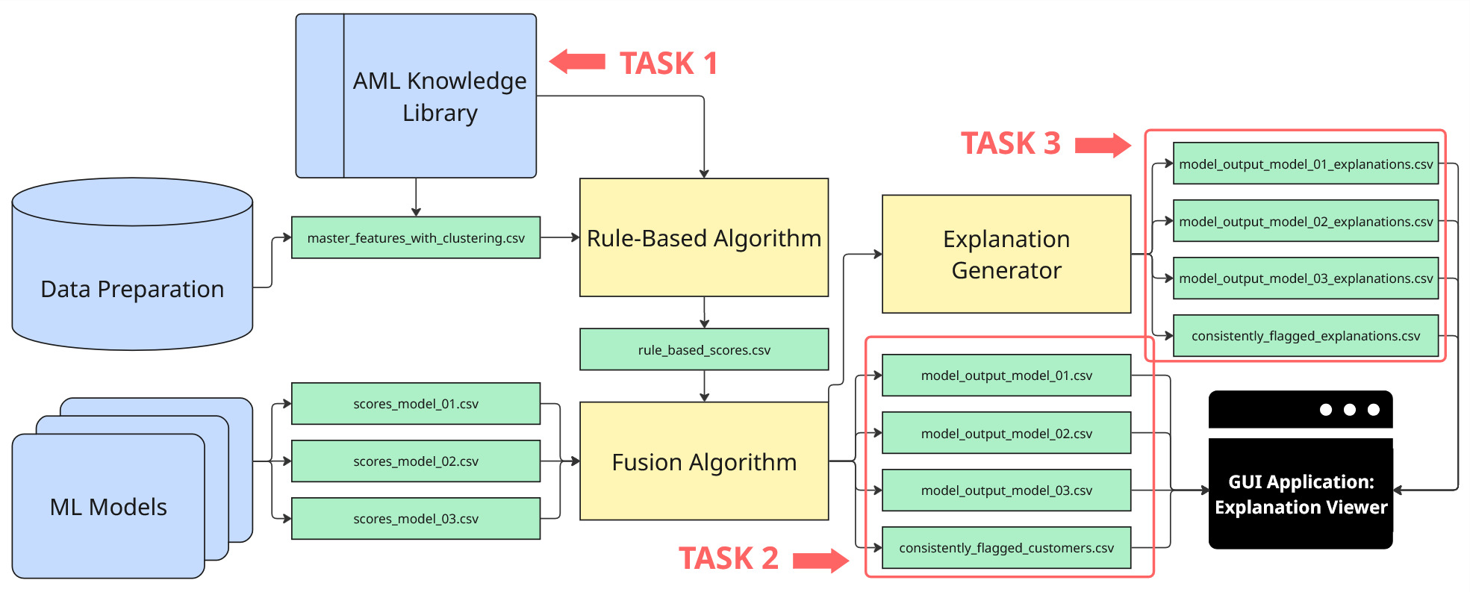
Introduction: Deliverables Summary

Slide 5
Introduction: Deliverables Summary
Everything is in the AML_Submission folder:
Dataset, AML Library, Pipeline, Trained ML Models, and Required CSV’s

Slide 6
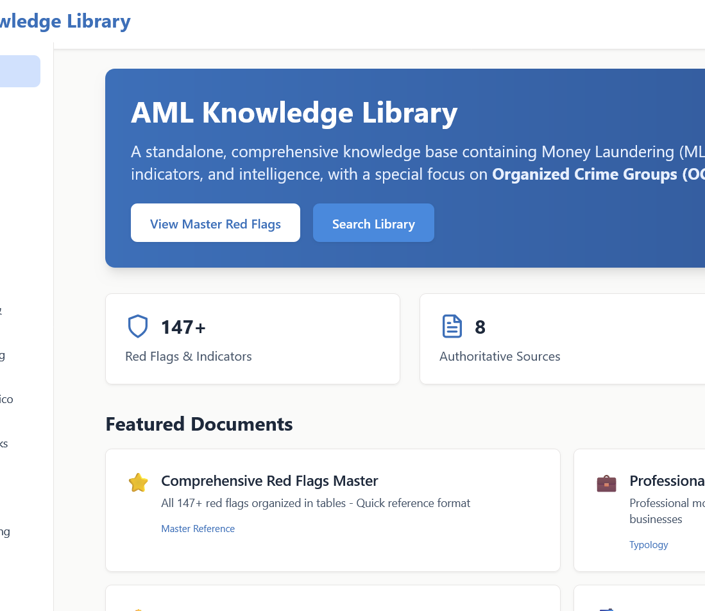
Presentation Overview
1. AML Knowledge Library: How is it built? Who is it for? How did we use it to guide data prep and feature engineering?

Slide 7
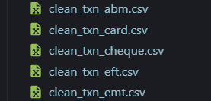
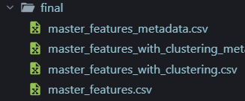
Presentation Overview
2. Data Preparation: Data cleaning + Feature engineering

Slide 8

Presentation Overview
3. Clustering: How does it connect to the bigger picture?

Slide 9

Presentation Overview
4. ML Algorithms: Unsupervised models that were tested, why they were used, and how they scored each customer.

Slide 10
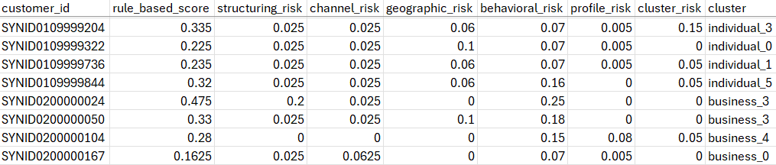
Presentation Overview
5. Pipeline: Rule-Based Algorithm
How it incorporates insights from AML Library, engineered features, and clustering to produce rule-based scores for every customer.

Slide 11
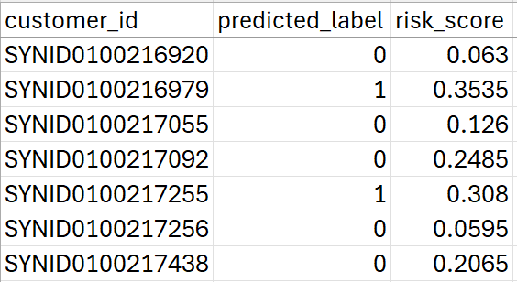
Presentation Overview
6. Pipeline: Fusion Algorithm
How it fuses rule-based scores with unique scores from each model to produce Task 2 deliverables.

Slide 12
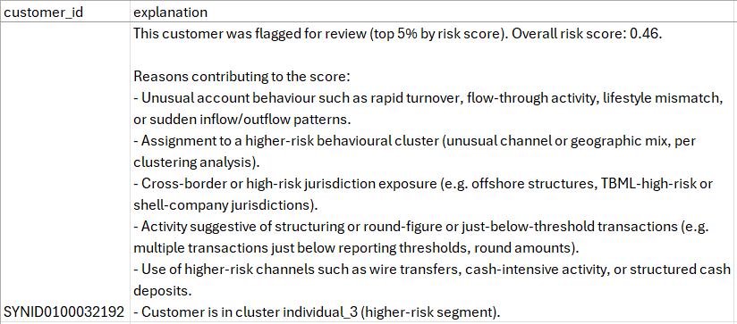
Presentation Overview
7. Pipeline: Explanation Generator
How it fuses rule-based scores with unique scores from each model to produce Task 3 deliverables.

Slide 13
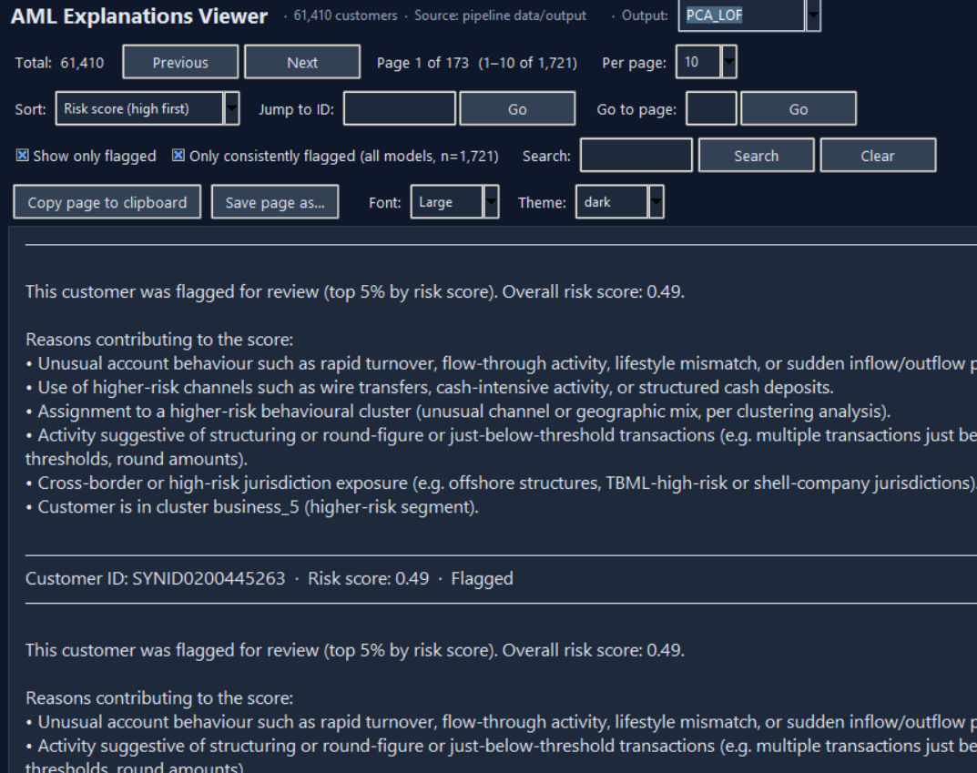
Presentation Overview
8. Python GUI App: Explanation Viewer

Slide 14

AML Library: Website + Markdown Docs
Content: 147+ red flags and indicators from 8 typology documents (trade-based ML, bulk cash, oil smuggling, Chinese ML networks, synthetic opioids, underground banking, human trafficking, general ML/TF), with a focus on organized crime.
Single reference: 00_COMPREHENSIVE_RED_FLAGS_MASTER.md — all red flags in one place with quick navigation.
Deep dives: Documents 01–08 give context, risk guidance, and high-risk combinations per typology.
Traceability: Every red flag is tied to a source — FINTRAC/FinCEN alerts and advisories — with URLs and references in SOURCES.md and inline citations.
Linking to data: Red_Flag_to_Feature_Mapping.md maps each red flag to data signals and engineered features used in detection (feeds Task 2 & 3).
Format: Markdown, organized and easy to use for both modelling and investigation (organized, accessible, and fully traceable via source information).

Slide 15
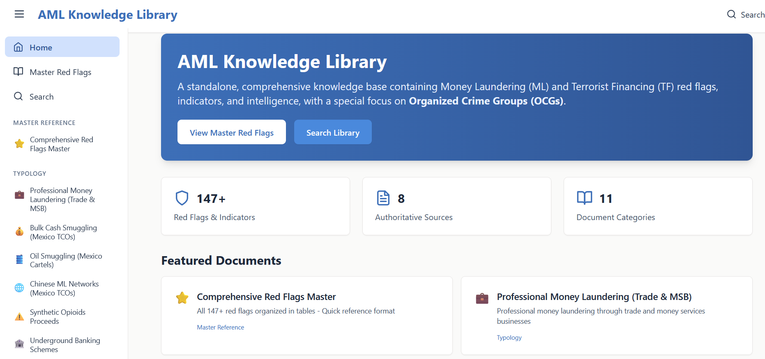
https://code-of-toad.github.io/utm-25-26-IMI-big-data-AI-Competition/

Slide 16

AML Library: Who is it designed for?
Primary Users:
Modelling experts
Use Case:
Link AML library content to data signals and features, using the suggested red flags as a guideline.
Use Case:
Understand risk patterns and design interpretable detection models.

Slide 17
AML Library: Who is it designed for?
Secondary Users:
AML investigators and professionals
Use Case:
Reference during investigations and due diligence.
Use Case:
Spot suspicious patterns and justify decisions with source-backed indicators.

Slide 18

AML Library: How we used it for feature engineering
Used the mapping document to decide which signals and features to build from KYC and transaction data (e.g. structuring, channel, geographic, behavioral, profile).
Aligned feature categories in the pipeline (rule-based scorer and explanations) with library typologies and red-flag categories so detection and explanations stay consistent with Task 1.
Metadata ties each feature to a typology doc for traceability; rule thresholds were chosen to reflect those risk patterns (e.g. round amounts, wire volume, flow-through).

Slide 19
AML Library: Markdown Docs (How to use it)
Quick scan:
00_COMPREHENSIVE_RED_FLAGS_MASTER.md for all red flags in one place.
Deep dive:
Documents 01–08 for typology-specific context and risk guidance.
Traceability:
SOURCES.md for full citations; inline references in each document.
Link to data:
Red_Flag_to_Feature_Mapping.md maps red flags → data signals → features.

Slide 20
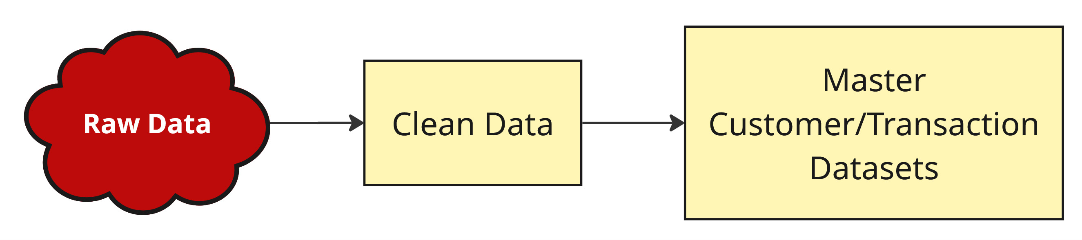
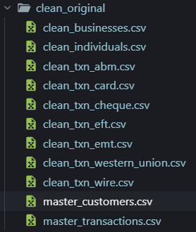
Data Preparation
Raw KYC and transaction data are cleaned into master customer and transaction tables.

Slide 21
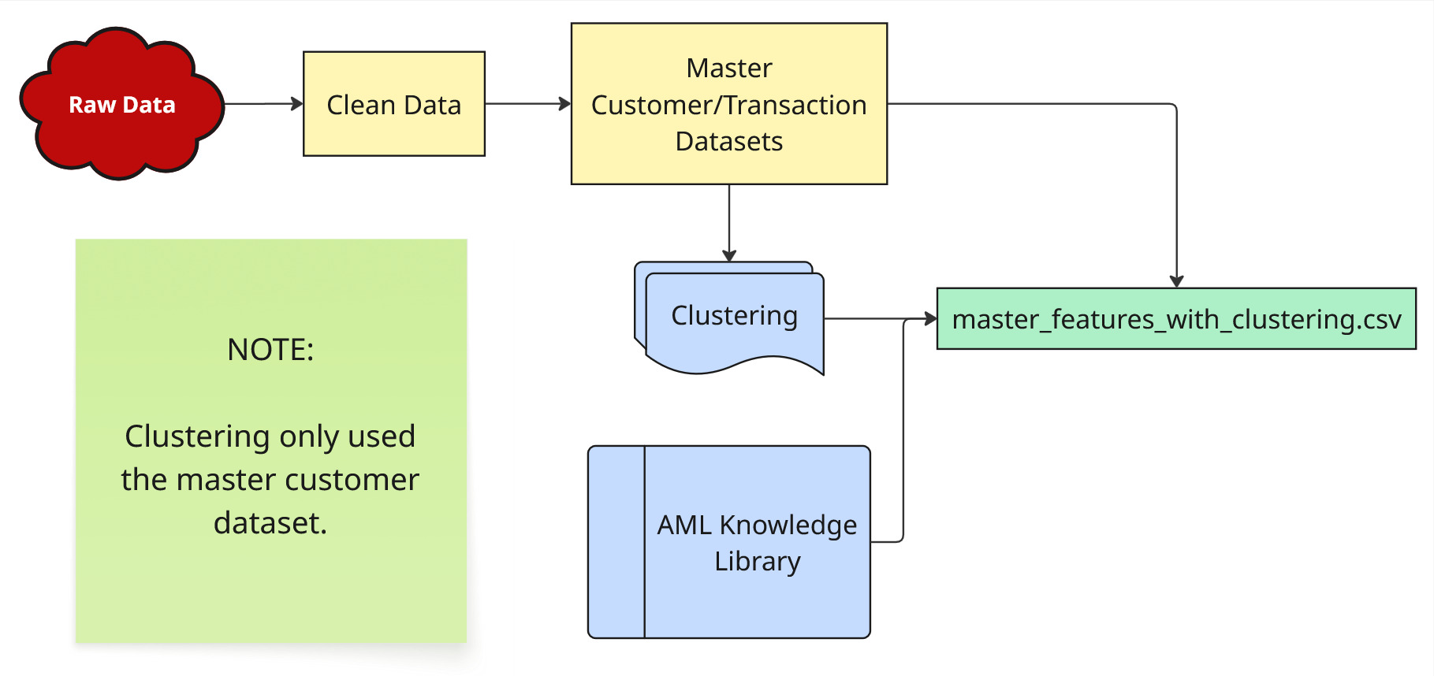
Data Preparation
Engineer features from those tables using the AML Knowledge Library (red-flag mapping) and run clustering on the customer (and transaction-derived) data.
We merge the cluster labels into the feature table to get:
master_features_with_clustering.csv

Slide 22
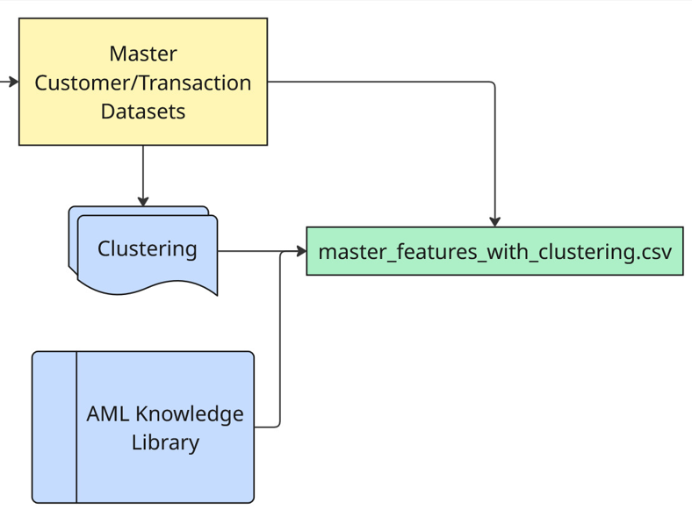
master_features_with_clustering.csv
Columns: customer_id, kyc_type, 180+ engineered features, and cluster.
Feature groups (aligned with AML library / pipeline):
Velocity: Transaction counts, per-day rates, flow-through timing, turnover, sudden inflow/outflow.
Amount / structuring: Means, round amounts, just-below-threshold counts, structuring flag, large-txn counts (10k/50k/100k).
Channel: Wire, ABM/cash, Western Union, EFT/EMT/card/cheque volumes and flags; multi-channel.
Geographic: Country/province/city diversity, cross-border flags, high-risk jurisdiction flags (e.g. offshore, TBML, shell).

Slide 23
master_features_with_clustering.csv
Columns: customer_id, kyc_type, 180+ engineered features, and cluster.
Feature groups (aligned with AML library / pipeline):
Time: After-hours, weekend, midnight/early-morning counts and percentages; rapid-fire; business vs non-business hours.
Behavioral: Volume vs income/sales, lifestyle mismatch, missing income/sales, single-txn vs revenue, consistency.
Profile: Account/business age, new-account flags, industry/entity flags (MSB, shell, cash-intensive, real estate, etc.), missing KYC.
Transaction-derived: Per-customer stats of transaction-level risk scores (max/mean/std, count/pct above threshold).
Cluster: Segment label from clustering (e.g. individual_1, business_2).

Slide 24
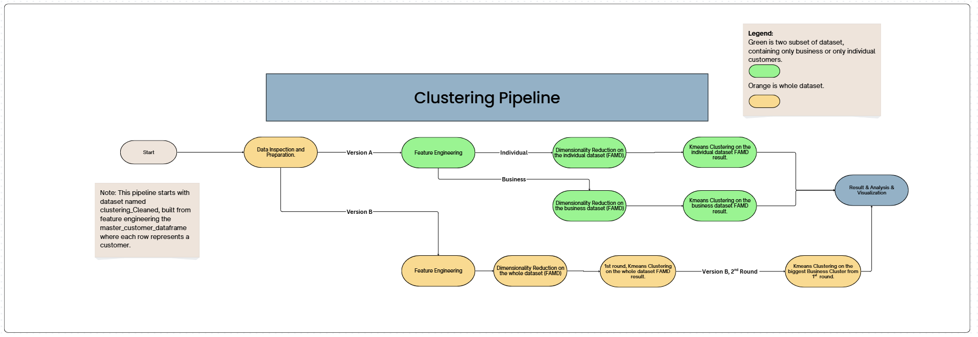
The Clustering Pipeline
Benefit of having two versions:
Version A: Better Segmentations within customers seperated by kyc_type.
Version B: Able to capture cross kyc_type behaviors, such as businesses that act like individuals.
Related Files Located in Clustering_Final in the submission folder!
Link of flowchart (pipeline): https://www.canva.com/design/DAHCACUQ-Fc/54Ri5o7MwT-jzSxdMYTZ8g/edit?utm_content=DAHCACUQ-Fc&utm_campaign=designshare&utm_medium=link2&utm_source=sharebutton

Slide 25

Dimensionality Reduction (FAMD)
Factor Analysis for Mixed Data (FAMD) is a dimensionality reduction techique targeted to handle mixed data combining both numerical or categorical variables.
Primary Purpose: Reduces time complexity of clustering algorithms, allow using eculidean distance.
n_component: total amount of factors (columns) to generate.

Slide 26
Results & Analysis: Understanding Silhouette and Elbow Scores
Silhouette score: Measures how well a point fits within its cluster vs. other clusters.
Range: -1 to 1; higher values indicate better separation.
Elbow inertia: Total within-cluster sum of squared distances (cluster compactness).
Elbow point: Where inertia decreases more slowly, indicating diminishing returns from adding clusters.

Slide 27
Result & Analysis: Understanding Heatmap
Heatmap scores ranges from 0 to 1.
Lower indicates that most customers in the cluster either do not exhibit this category or have relatively lower values compared to other clusters for numerical features.
Higher means most customers in the cluster either have this category or have relatively higher values compared to other clusters for numerical features.

Slide 28
Clustering Version A:
K=9(individual)+7(business)=16 total clusters
Business-Specific Clusters
Silhouette score: 0.3441
Elbow inertia: 72795.91
Individual-Specific Clusters​
Silhouette score: 0.3316
Elbow inertia: 826721.5

Slide 29
Version A: Cluster Sizes
Individual-Specific Clusters
individual_0 11501
individual_1 4708
individual_2 4402
individual_3 14730
individual_4 601
individual_5 362
individual_6 1259
individual_7 14134
individual_8 1402
Business-Specific Clusters
business_0 4048
business_1 179
business_2 1200
business_3 1900
business_4 626
business_5 250
business_6 108

Slide 30
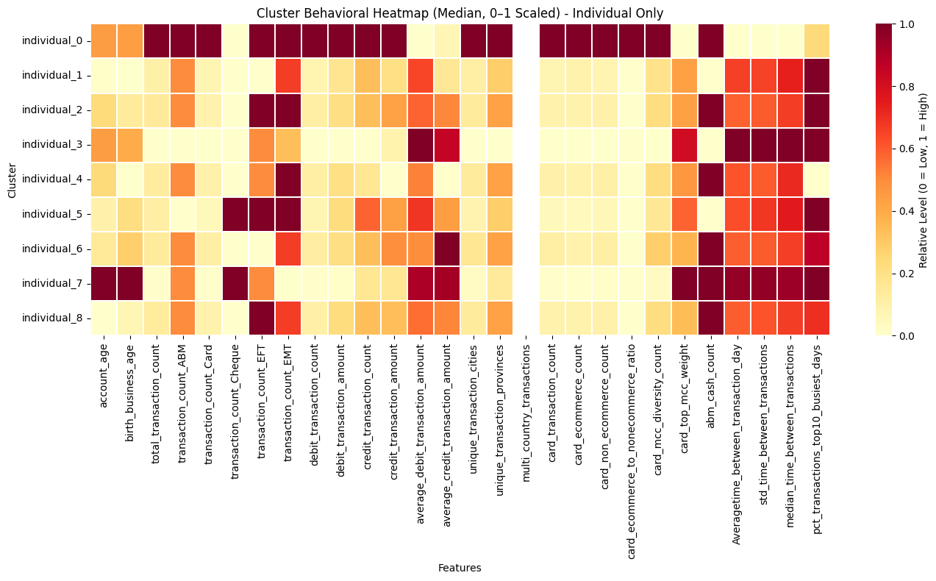

Slide 31
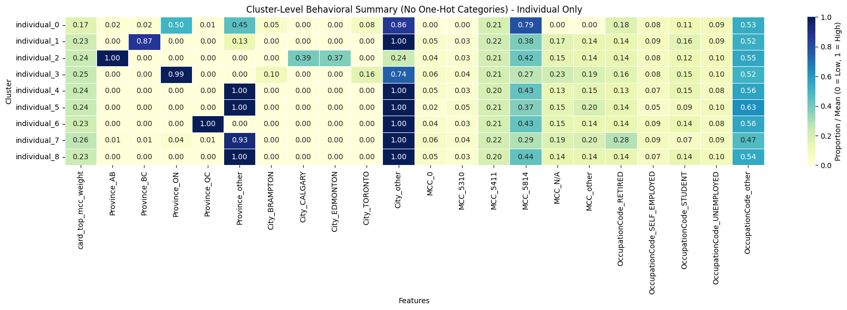
Individual-Specific Clusters

Slide 32
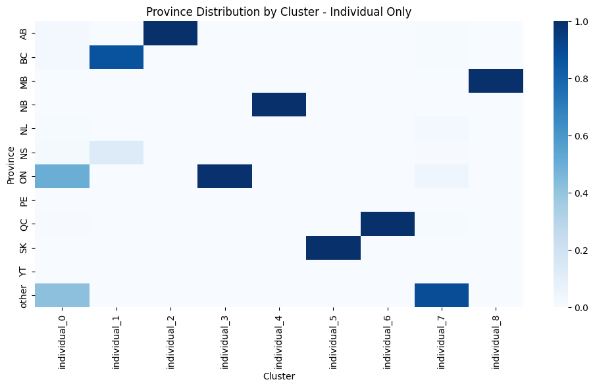

Slide 33
Clustering Version B:
K=9 (1st round) +7 (2nd round) -1(dissolved business cluster from 1st round) =15 total clusters
1st round metrics:
Silhouette score: 0.3516
Elbow inertia: 1169921
2nd round metrics
Silhouette score: 0.3223
Elbow inertia: 76903.11

Slide 34
Version B: Cluster Sizes:
1st round :
Cluster 0 20232
Cluster 2 663
Cluster 3 20846
Cluster 4 845
Cluster 5 1511
Cluster 6 4762
Cluster 7 453
Cluster 8 5160
Note: Cluster 1 from first round was used for 2nd round since 99%~ of customers are business kyc_type
​
2nd Round:​
business_0 193 ​
business_1 1361 ​
business_2 2533 ​
business_3 48 ​
business_4 1855 ​
business_5 264 ​
business_6 684​

Slide 35
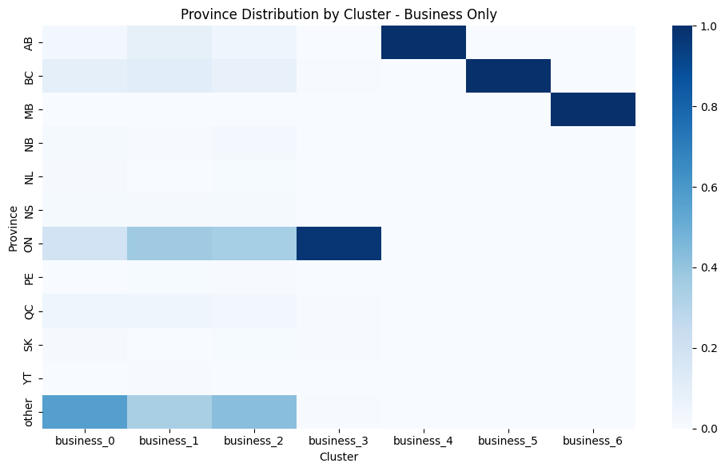
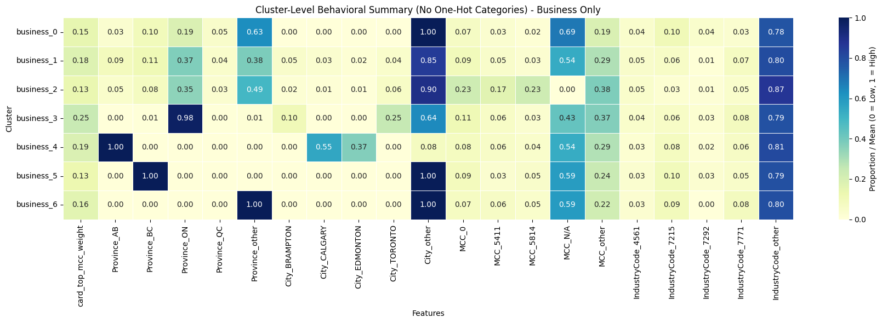
Business-Specific Clusters

Slide 36
Websites for understanding (References)
Prince Package (FAMD) for Dimensionality Reduction:
https://maxhalford.github.io/prince/famd/
Silhouette and Elbow Score for Clustering
https://www.geeksforgeeks.org/machine-learning/what-is-silhouette-score/
https://www.geeksforgeeks.org/machine-learning/elbow-method-for-optimal-value-of-k-in-kmeans/

Slide 37
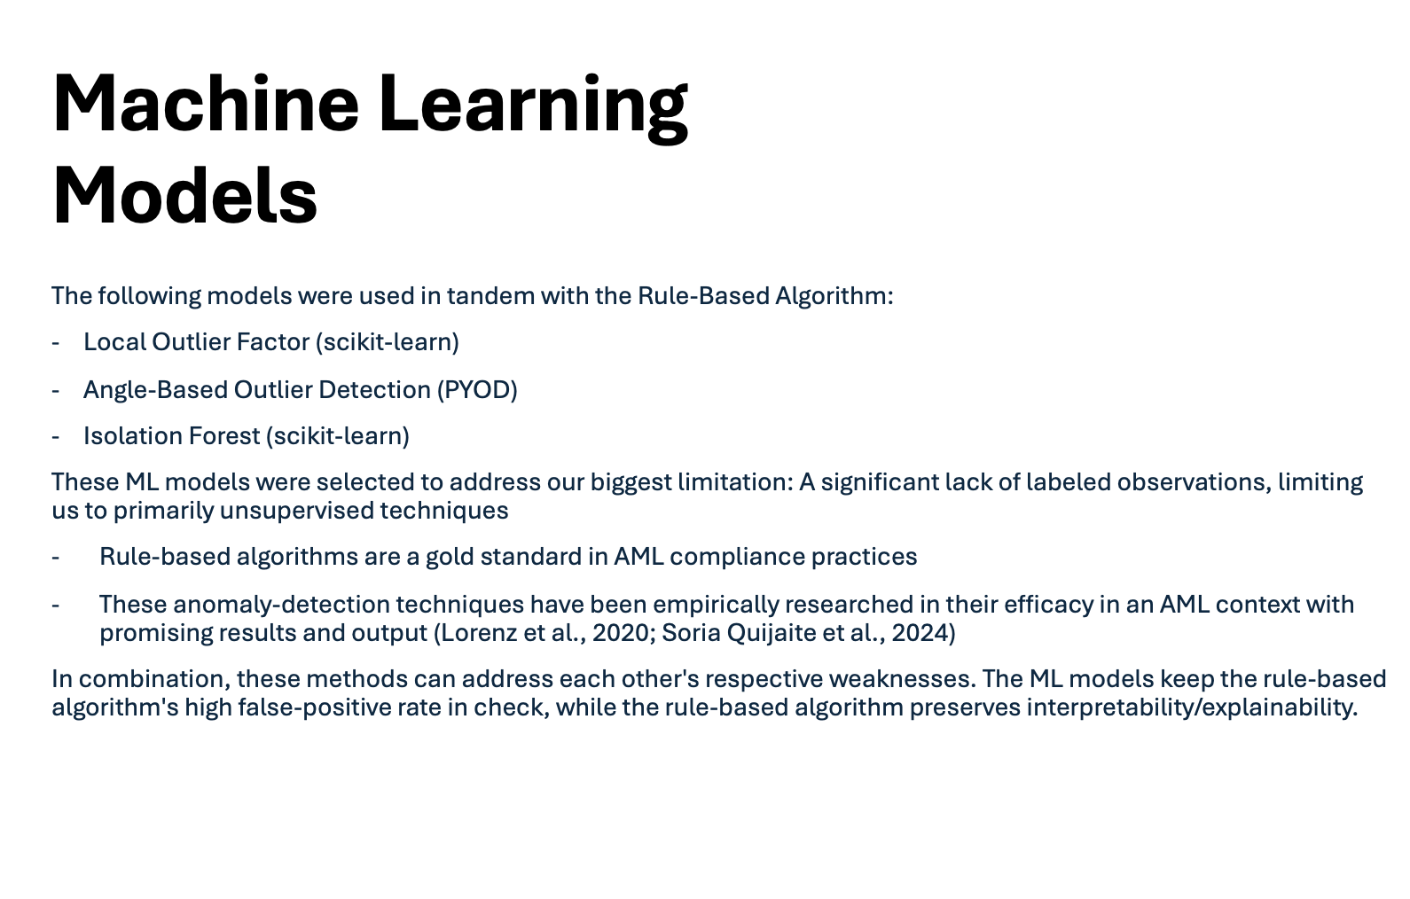

Slide 38
Tuning LOF and ABOD
LOF was fit on the dataset in two different ways:
1) On PCA output of the full dataset of every customer (master_features_with_clustering.csv, n = 61,410) with non-numeric columns removed
2) On FAMD output of each of the 16 clusters that partition the full dataset of customers from Version A
ABOD was fit on the numeric columns of master_features_with_clustering.csv directly
For both models, hyperparameters are tuned by assessing rank-stability of labeled observations across different values neighboring k ≈ √𝑛 (Breunig et al., 2000)
The contamination parameter is set to 'auto' to maintain compatibility with the rule-based algorithm

Slide 39
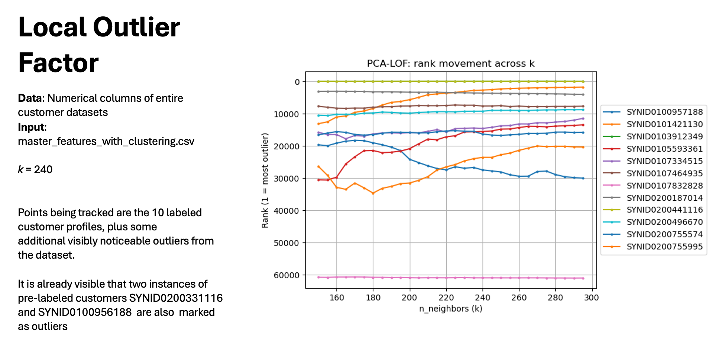

Slide 40
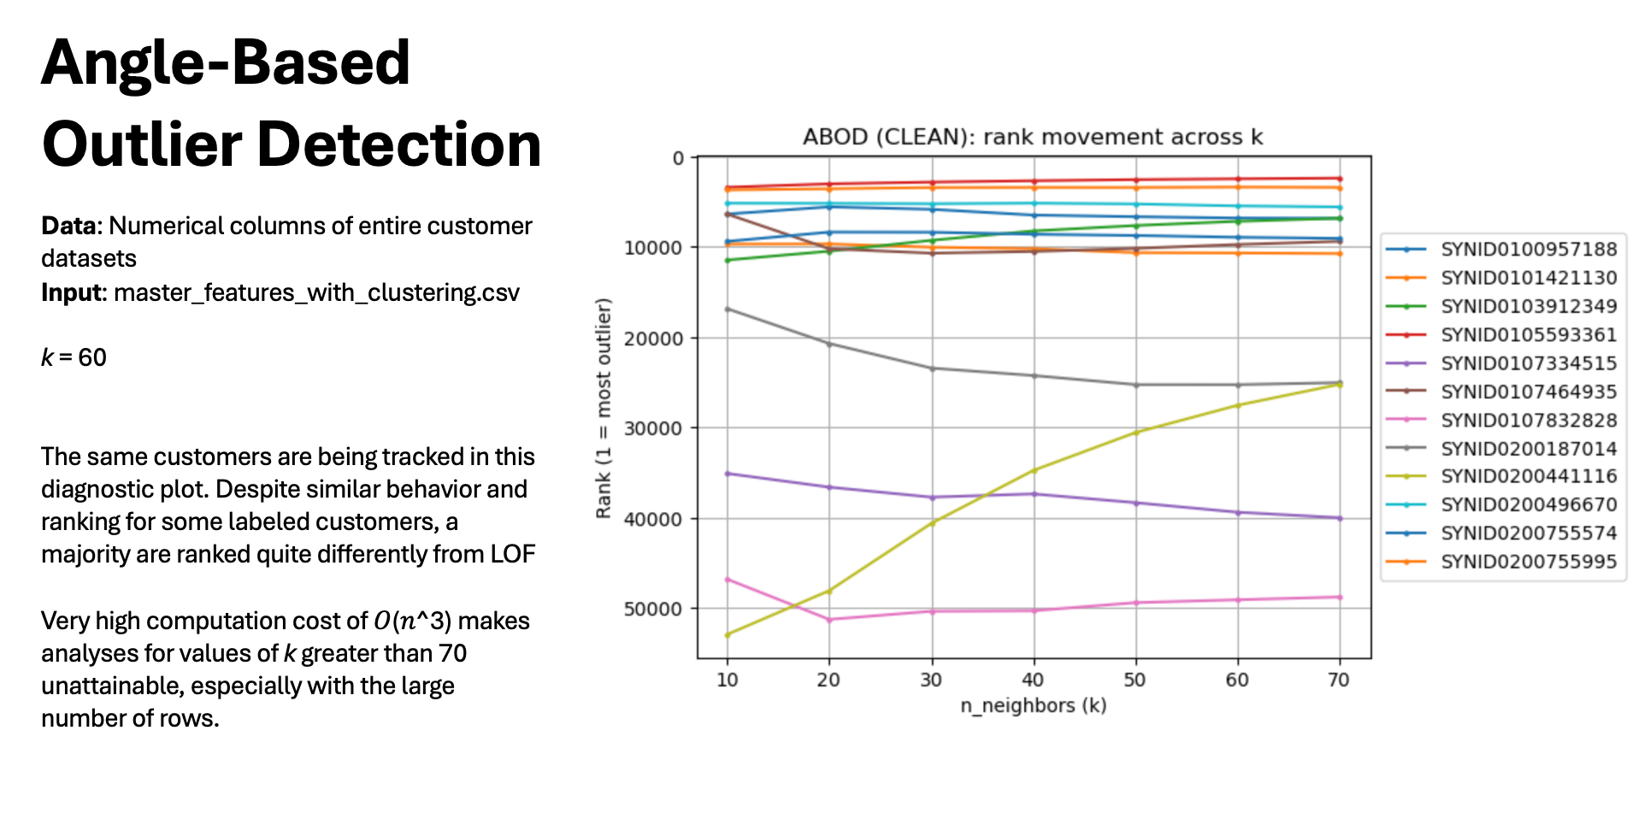

Slide 41
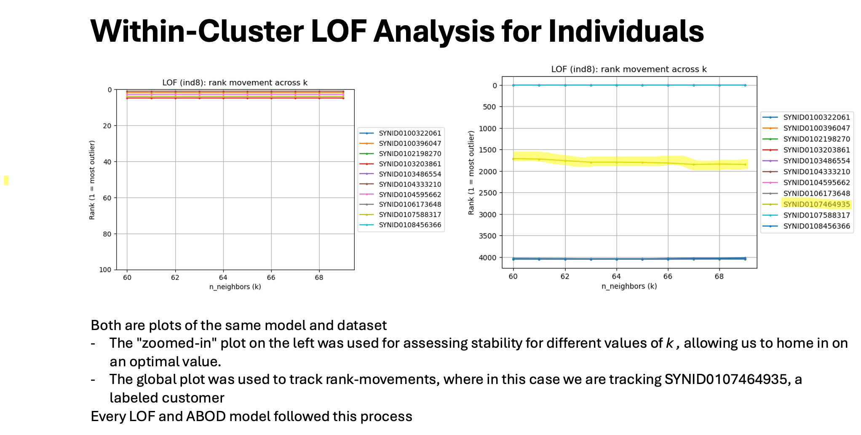

Slide 42
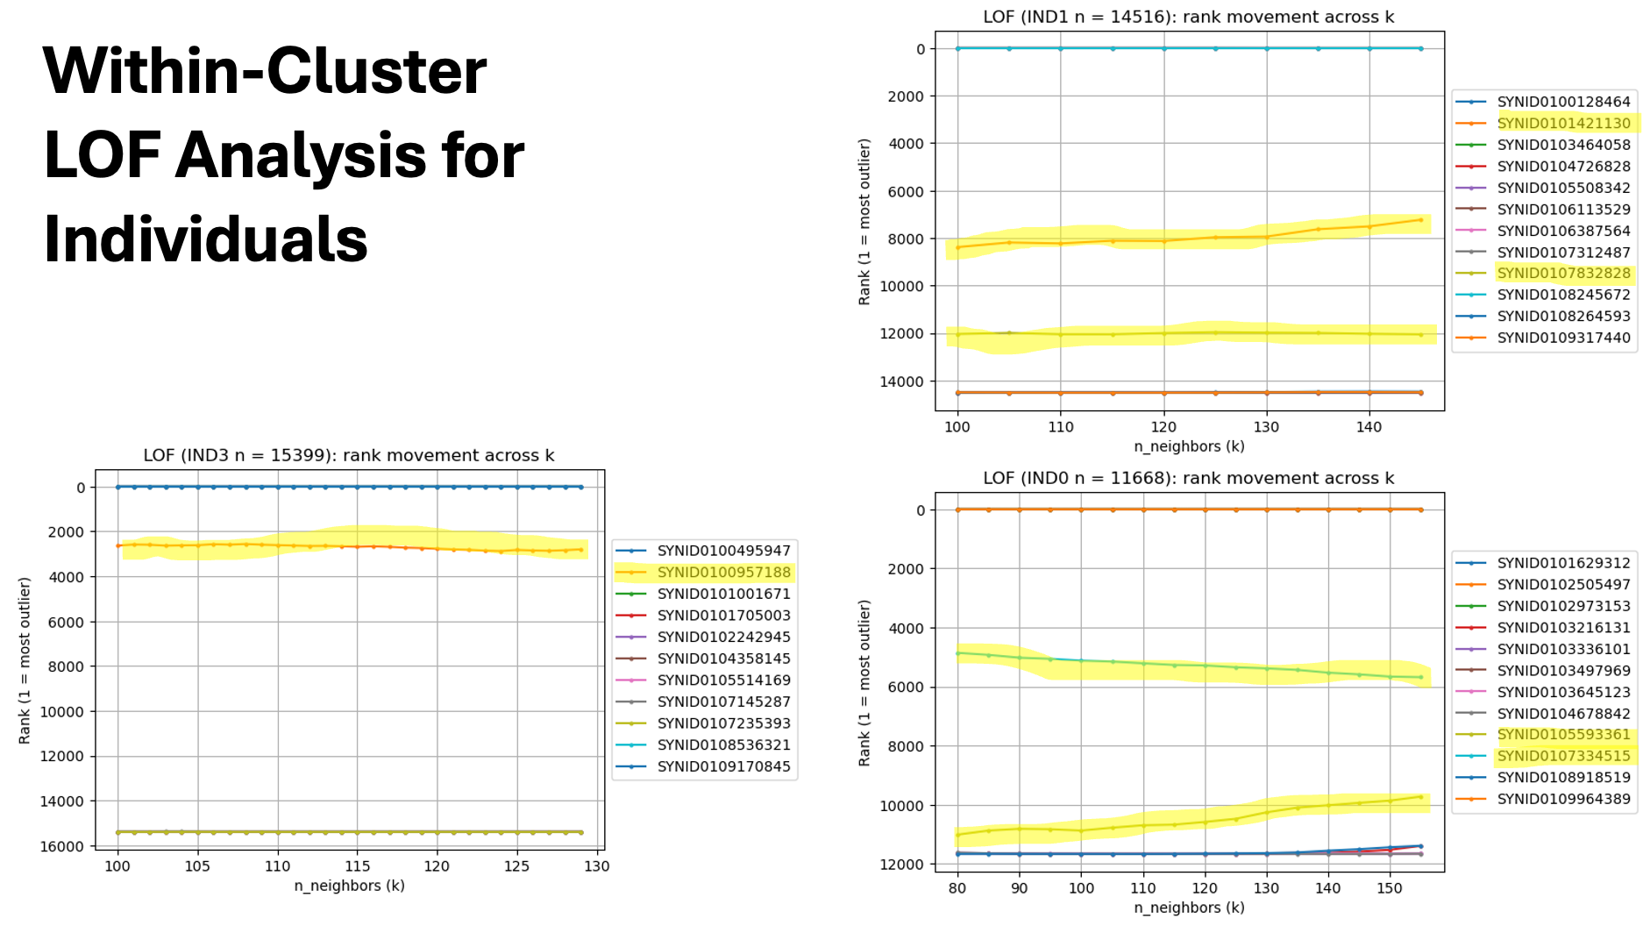

Slide 43
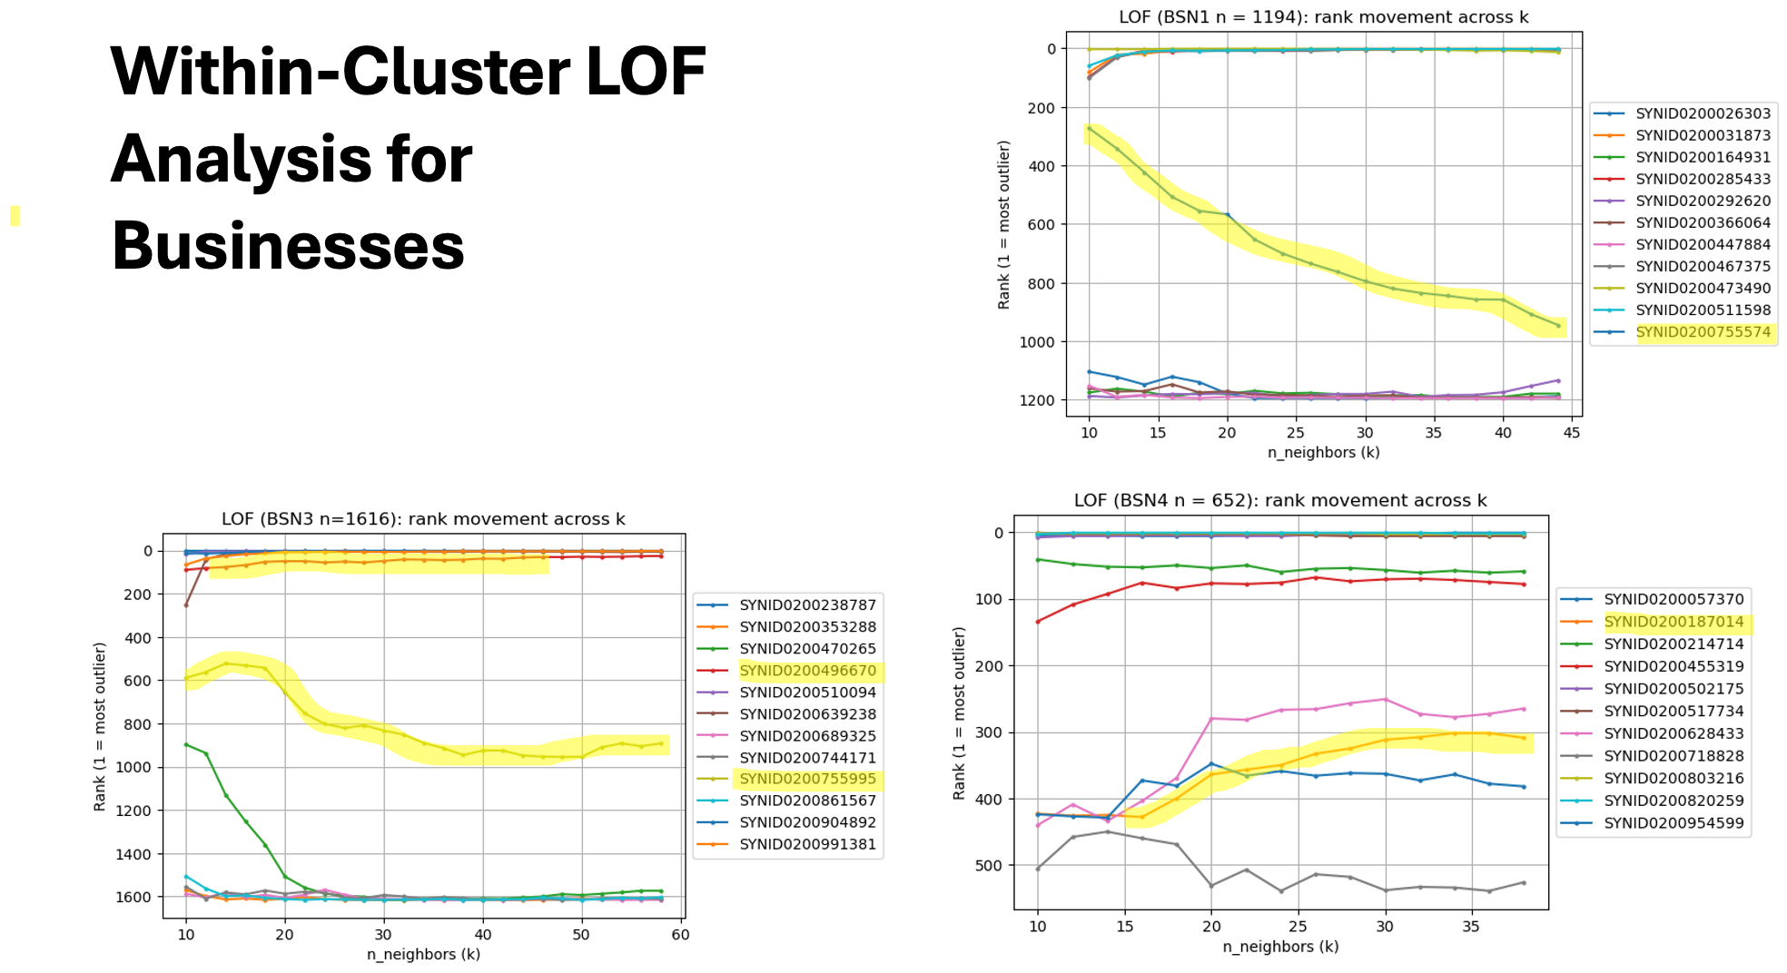

Slide 44
Isolation Forest
Parameters:
contamination=0.05 to match the “top 5%” flagging used elsewhere
n_estimators=100 for stability vs cost
max_samples="auto" (256)
random_state=42 for reproducibility
Preprocessing:
StandardScaler on numeric features (excluding rule-based columns) so high-magnitude features (e.g. volumes) don’t dominate
missing/inf handled with median fill
Output:
Raw score_samples (negative = more anomalous) are min–max scaled to [0,1] and inverted
I.e., higher = more anomalous

Slide 45
How will it all come together???

Slide 46
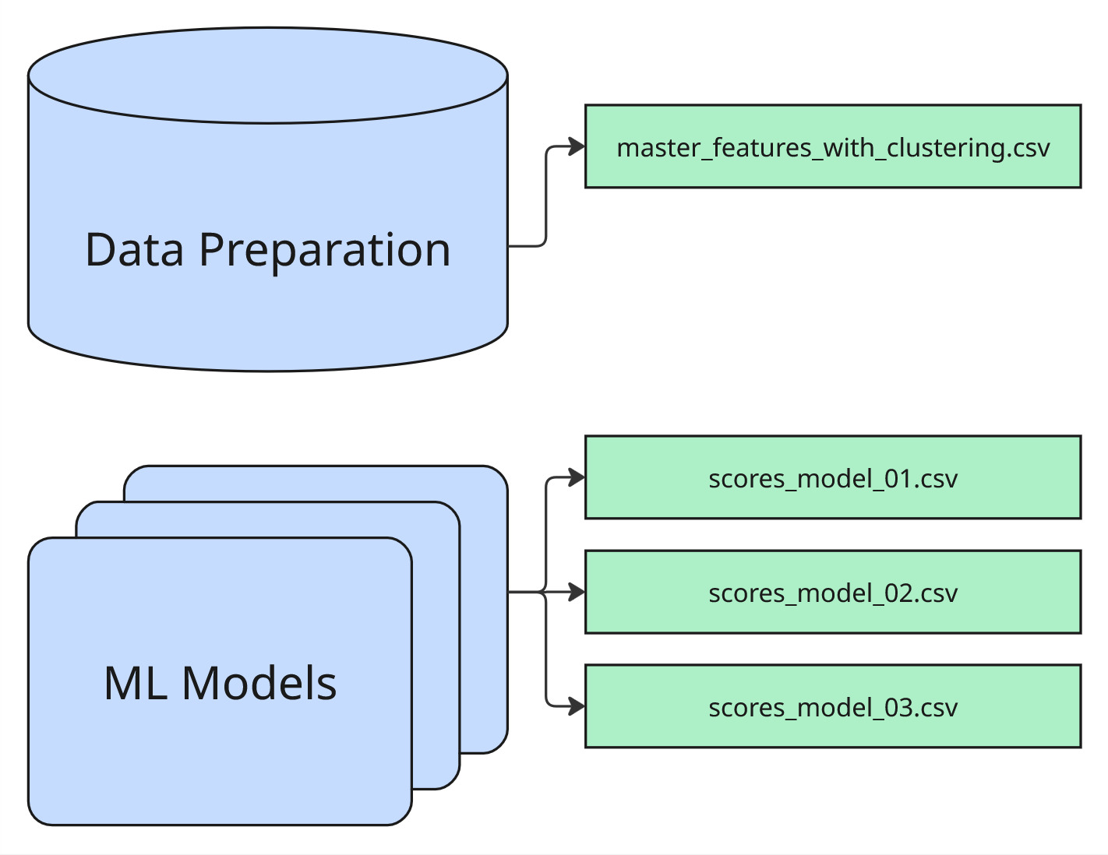
So far, we have…

Slide 47
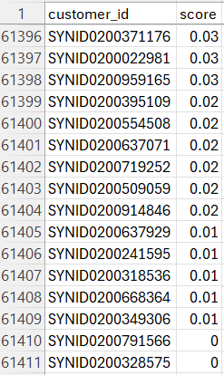
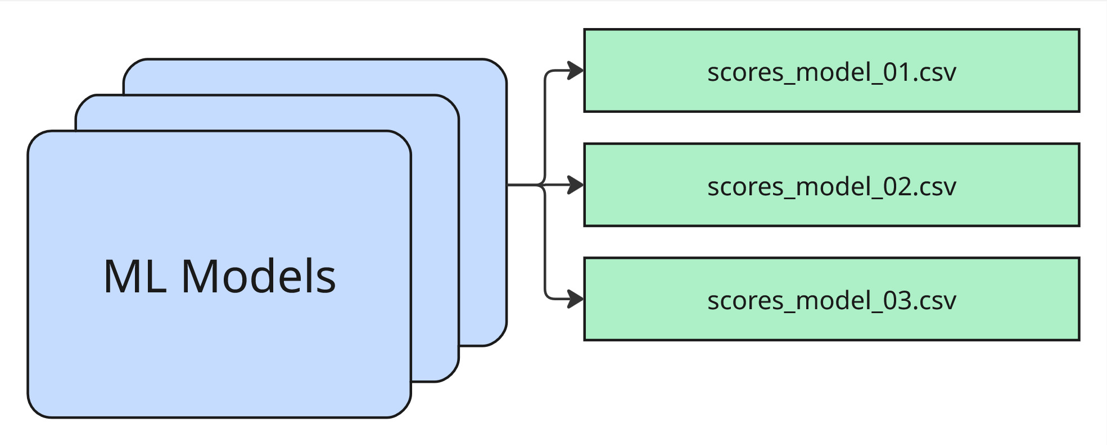
So far, we have…

Slide 48
Pipeline for Task 2 + Task 3

Slide 49
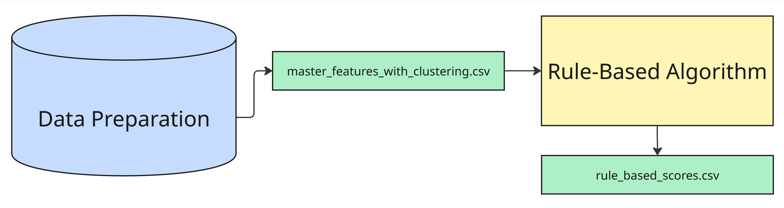
Pipeline: Rule-Based Algo
Five risk categories (aligned with the AML library), each with a weight and a set of feature → threshold → weight rules:
Structuring & Amount (25%)
Channel (25%)
Geographic (20%)
Behavioral (20%)
Profile (10%)

Slide 50
Five Risk Categories: Examples
1. Structuring & amount (25%):
just_below_threshold_count ≥ 3
structuring_pattern_flag ≥ 1
round_amount_pct ≥ 0.5
large_txn_count_10k ≥ 5
large_txn_count_50k ≥ 2
2. Channel (25%):
has_wire_transfers
wire_large_count
wire_volume_total
has_western_union
abm_cash_*
structured_cash_deposits_same_day
multi_channel_flag
3. Geographic (20%):
cross_border_flagcross_border_txn_pct ≥ 0.3
is_country_offshore_structure_jurisdiction
is_country_tbml_high_risk
is_country_shell_company_jurisdiction.
4. Behavioral (20%):
lifestyle_mismatch
severe_lifestyle_mismatch
flow_through_velocity_hours ≥ 24
account_turnover_rate ≥ 2
sudden_inflow_outflow_pattern
single_txn_exceeds_revenue
5. Profile (10%):
is_msb_business
is_shell_company
is_cash_intensive
new_account_flag
very_new_business_flag
high_profile_risk.

Slide 51
Pipeline: Rule-Based Algo
Scoring:
For each category, every rule that meets its threshold adds that rule’s weight.
The category total is multiplied by the category weight (e.g. 0.25).
All five category contributions are summed and normalized to [0, 1] → base rule-based score.

Slide 52
Pipeline: Rule-Based Algo
Cluster Boost:
If a cluster column exists, some clusters get a fixed add-on (e.g. +0.15 for high-risk, +0.05 for secondary)
Again, the result is clipped again to [0, 1] → final rule-based score.

Slide 53
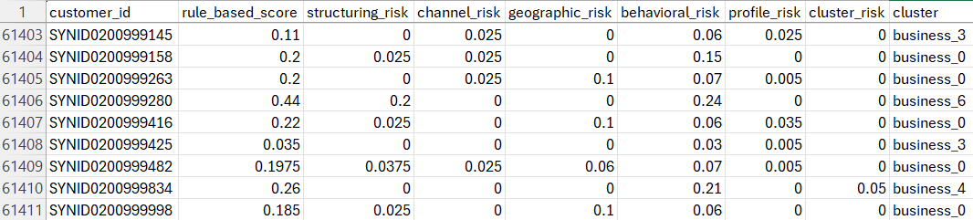
Pipeline: Rule-Based Algo OUTPUT

Slide 54
Pipeline: Fusion Algo

Slide 55
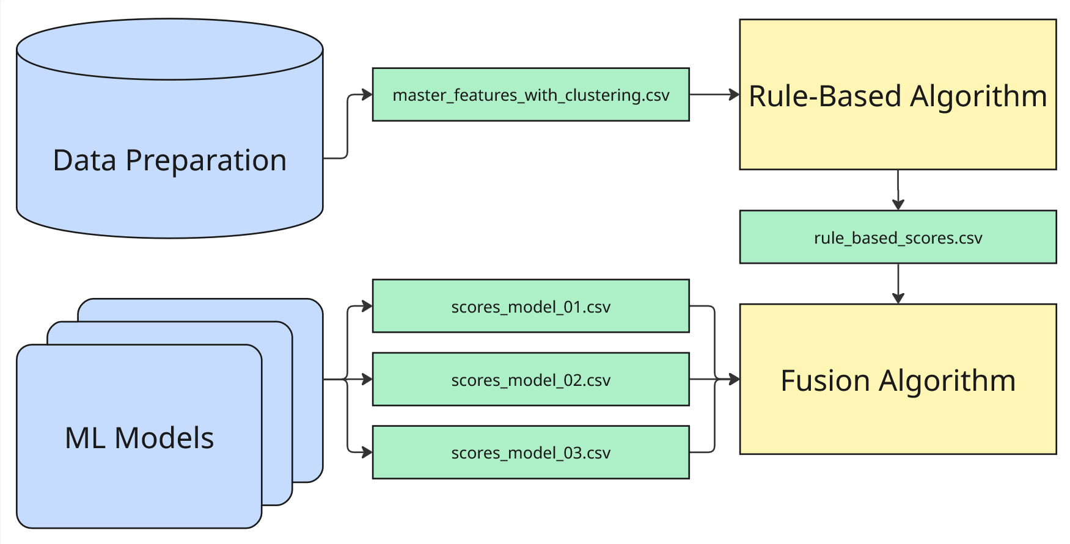
Pipeline: Fusion Algo

Slide 56
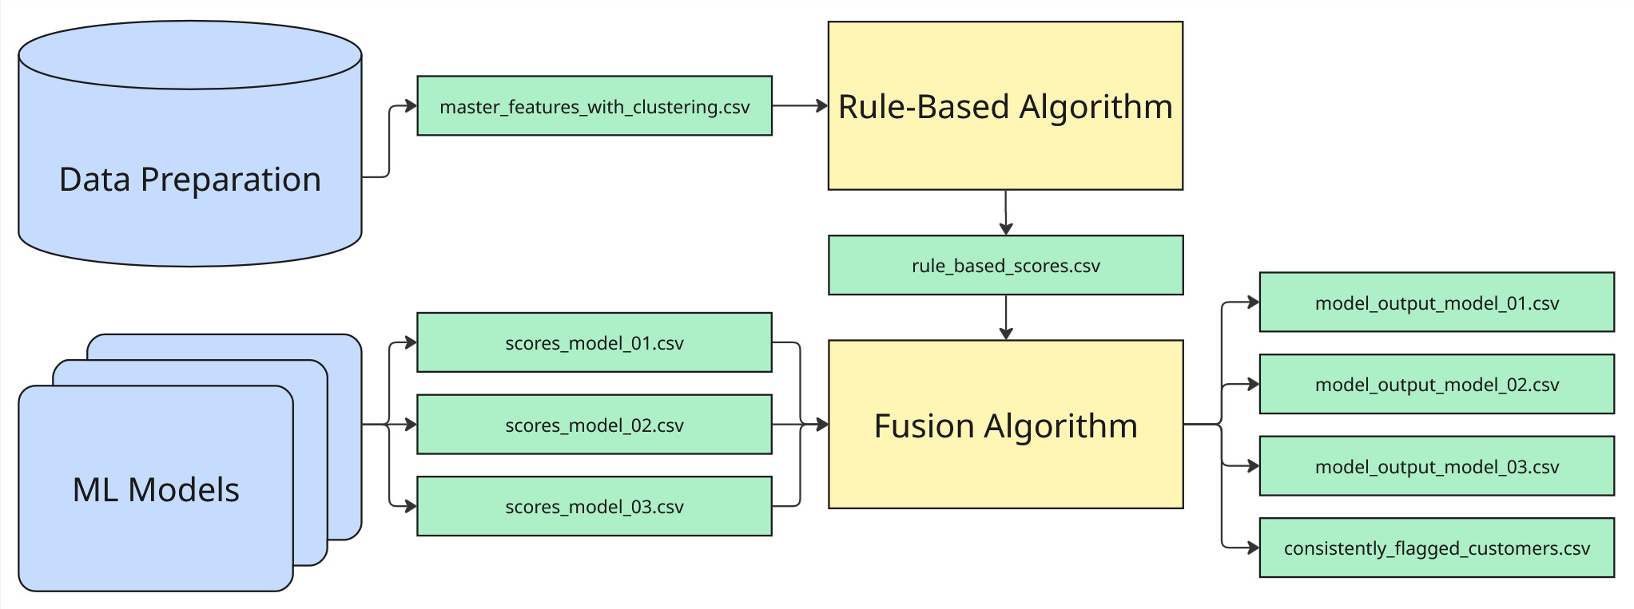
Pipeline: Fusion Algo

Slide 57
Pipeline: Fusion Algo
Inputs:
rule_based_scores.csv (one score per customer)
Each ML model’s scores_*.csv (one anomaly score per customer)
Formula:
risk_score = 0.7 × rule_score + 0.3 × anomaly_score
Flagging:
Customers in the top 5% by risk_score get predicted_label = 1
The rest get 0
Output:
One model_output_<model>.csv per ML file: customer_id, predicted_label, risk_score. Same fusion is used for every model; only the anomaly file changes.

Slide 58
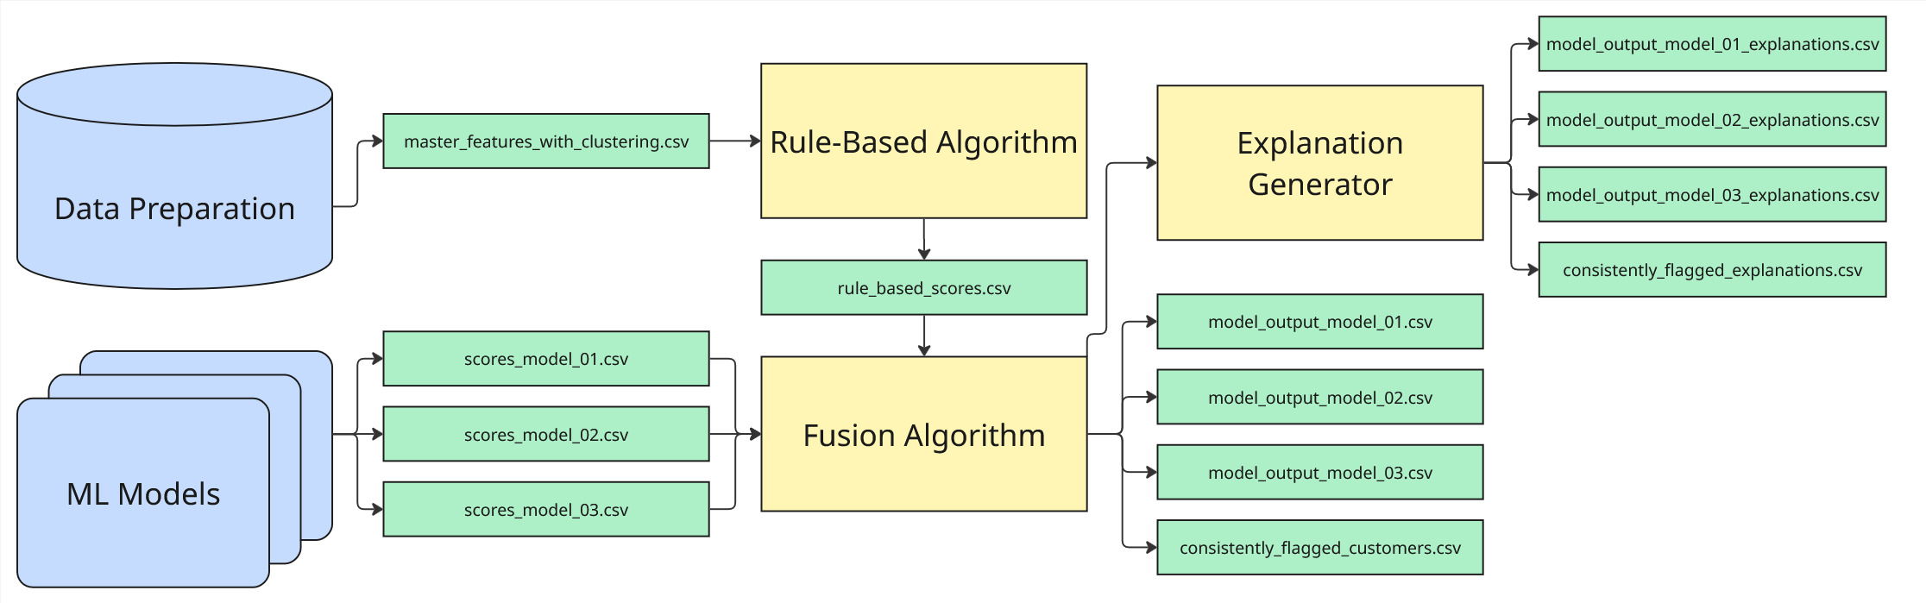
Pipeline: Explanation Generator

Slide 59
Pipeline: Explanation Generator
When: Runs right after fusion, once per model.
Inputs: Fused model_output_*.csv (customer_id, predicted_label, risk_score), rule_based_scores.csv (per-customer category scores: structuring, channel, geographic, behavioral, profile, cluster), and the same anomaly score file used in fusion (optional).
Logic: For each customer:(1) state flagged/not and risk score; (2) list “Reasons contributing to the score” from rule categories that contributed (using fixed, non-technical phrases from the AML library); (3) add an anomaly line if anomaly score ≥ 0.5; (4) add a cluster line if cluster_risk &gt; 0; (5) if not flagged but score is just below the threshold, add the borderline sentence.
Output: One explanation per customer, ≤2000 characters, written to model_output_<model>_explanations.csv (customer_id, explanation). No ML jargon; wording matches the rule categories so it’s usable by AML staff

Slide 60
Pipeline: Explanation Generator

Slide 61
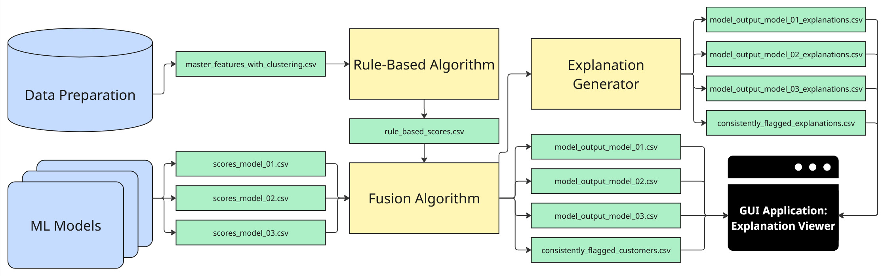
Pipeline: Explanation Generator

Slide 62
Python GUI App: Explanations Viewer

Slide 63

THANK YOU

